Slide 1

FedGroup: A Federated Learning Approach for Anomaly Detection in IoT
Environments
Presented by
Yixuan Zhang
Basem Suleiman
Muhammad Johan Alibasa

Slide 2
Introduction
Research Background
The number of Internet-connected devices in the household are increasing:
Cisco highlights that the number of connected devices per person in the smart home has surged rapidly from 0.08 in 2003 to 6.58 in 2020
However, IoTs are vulnerable to the majority of wireless network attacks:
Recent research reported that around 59% of users are concerned about speakers listening to them without permission and gathering data without their knowledge

Slide 3
Introduction
Research Question
Attack Detection: Can we determine whether it is an attack?
Research Aim
Our project is focused on Anomaly detection in IoT Environments.
The target audience is to help people who might have lots of Internet-connected devices in the household.
The aim is to automatically detect the attacks and report the fact to the human at hand.

Slide 4
Literature Review
Key Author | Theories / Model | Important contents for our project
Stojkoska et al., 2017 | A review of Internet of Things for the smart home: Challenges and solutions | Point out the challenges of a security issue and large data storage for cloud-based techniques
McMahan et al., 2017 | Federated learning model | Communication-Efﬁcient Learning of Deep Networks from Decentralised Data
Rahman et al., 2020 | Internet of Things Intrusion Detection: Centralised, On-Device, or Federated Learning? | The results prove that FL outperform the centralised learning model
Mohri et al., 2019 | Agnostic federated learning | Centralised model is optimised for any target distribution produced by a mixture of client distributions to fix unfairness
Li et al., 2020 | q-FFL | Configured at a more granular scale to ensure equitable device distribution and maintain the same overall accuracy
Vanerio and Casas, 2017 | Ensemble learning model: Super Learner for Network Security and Anomaly Detection | Ensemble learning for network security and anomaly detection have the ability to perform well results

Slide 5
Literature Review
Gaps
1. Research identifying the attack using FL is still scarce and has not been explored in depth.
2. Simply choosing the overall average in the central model ignores the bias of the individuals and causes unfair performance.
3. Combine Ensemble Learning and FL-based learning in the model

Slide 6

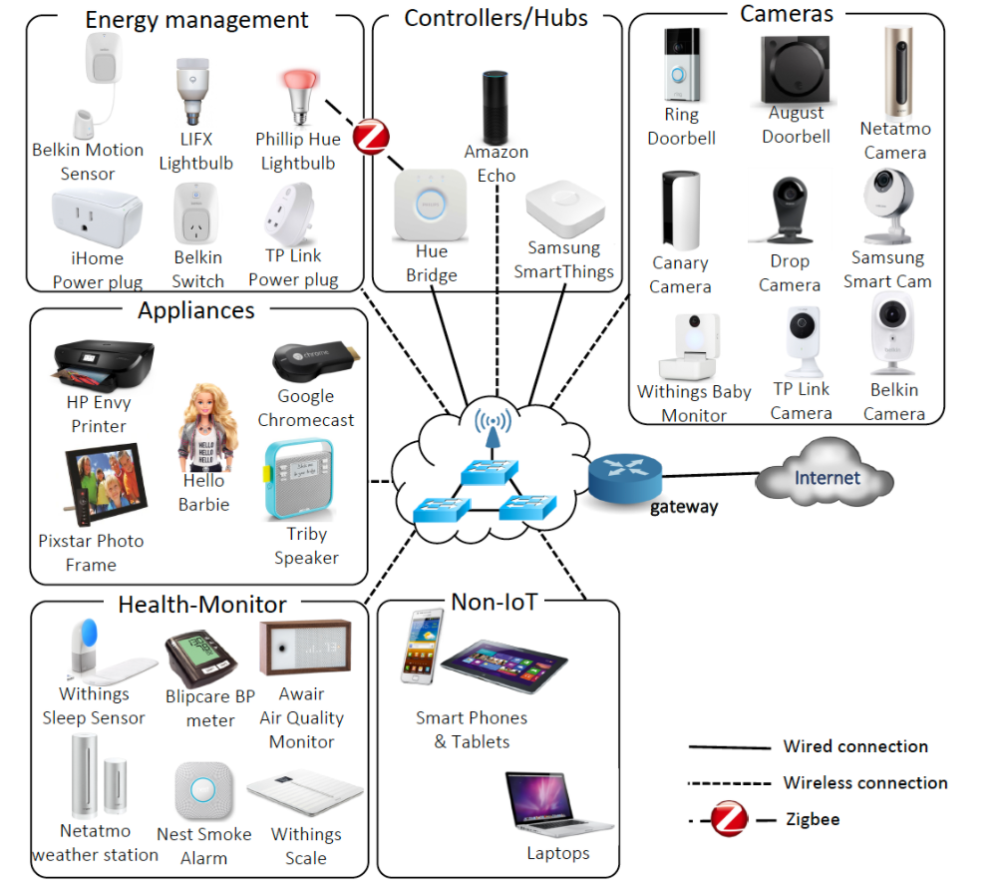
Methodology
Data
Our data are coming from UNSW IoT analytics.
They demonstrate the real-life threats to evaluate the privacy and security risks of IoT devices.
The lab setup is a specialised implementation of this architecture houses at UNSW facility.
It has a total of 28 unique IoT devices representing 6 different categories, along with several non-IoT devices.

Slide 7
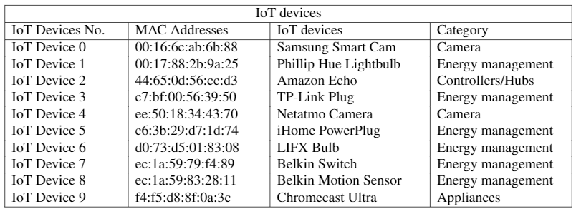
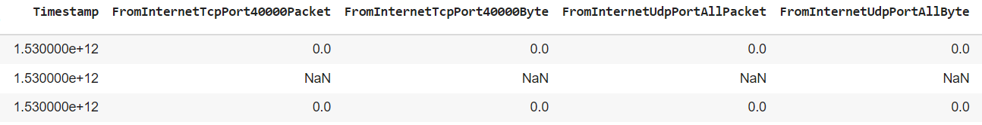
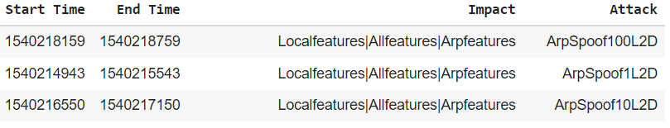
Methodology: Dataset
Network Traffic Flow Data
Attributes: From###Port###Packet, To###Port###Packet, From###Port###Byte, To###Port###Byte, Timestamp
Every minute collect once
Attack Data
Attributes: Start & end time of the attack, Impact and Attack Types

Slide 8
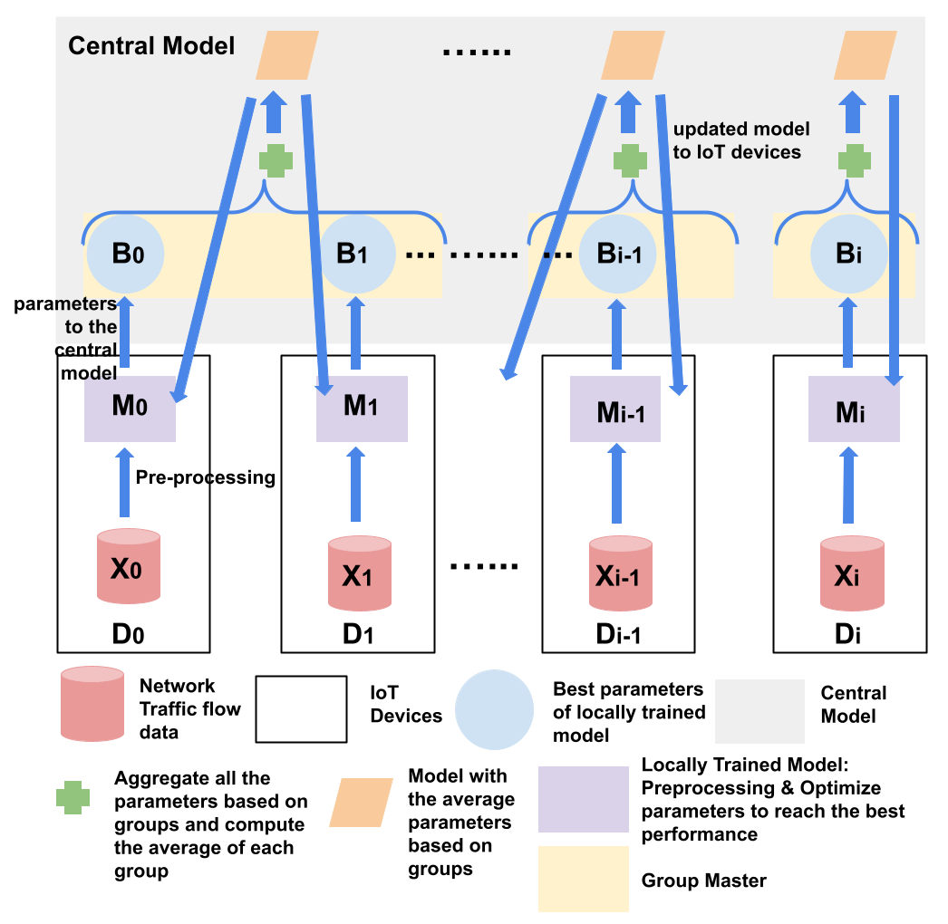
Methodology: FedGroup
Step 1: Every device have local model to compute training network traffic flow data with all parameters and send the parameters best results to the central model;
Step 2: Group master in the central model secure aggregate the parameters based on group without learning information about any participant;
Step 3: Group master sends back the aggregated results to participants in the related group;
Step 4: Local models update their model with the new parameters.

Slide 9
Comparison
Traditional Machine Learning: IoT devices send all the data to the central model for training models
Federated Learning (FedAvg): IoT devices training models locally and send the updates to the central model, the central model aggregate the average of the parameters for the next iteration
FedGroup: The central model aggregate the average of the parameters based on groups

Slide 10
Why Fairness?
The devices in the smart homes are not equally assigned in different groups
The result will be influenced by the extremely large/small updates
The same category of IoT devices have similar functionality, structure, and network traffic flow data patterns
The same category of IoT devices have similar vulnerable structure under similar attacks

Slide 11
Ensemble learning
Traditional Machine Learning:
Federated Learning (FedAvg) use the ML as the local model in every IoT device
The performances are not always perfect as expected because ML are used to solve a specific question or type of question.
Some perform good and some are not
Ensemble Learning:
Combine multiple models as one for a better forecast.
Use Ensemble learning as local model and Federated Learning-based model as central model

Slide 12
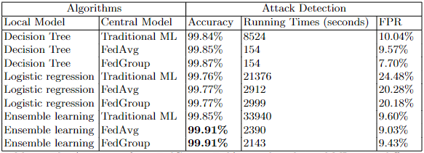
Results
1. Attack Detection: Determining whether it is an attack?
The highest accuracy of 99.91% reached by the FedGroup model using Ensemble Learning as the local model to train.
2. FL-based models perform equal or better performance than the traditional ML models.
Take the Decision Tree as the local model for attack type detection,
Traditional ML: 10.04% FPR, FedAvg: 9.57% FPR, FedGroup: 7.70% FPR
3. The running time of FL-based is less than the traditional ML model
For example, using Ensemble learning as the local model and FedGroup as the Central Model spends around 1/16 of time spend on Traditional ML and 0.9 of time spend on FedAvg.

Slide 13
Discussions
Support or reject current studies
The results of this study are consistent with those of Mohri et al. (2019) and Li et al. (2020), who suggest that uniform distribution is not the natural objective distribution in many situations and the issue of unfair. In light of the importance of bias of training data disclosure, it is imperative to address this gap in the research by aggregating updates based on groups.
Advice based on my results
Real-time detection
Expanding the model to other frameworks not limited to anomaly detection
Finding the system cost
How the link instability of wireless networks affects the model updating
Groups on features

Slide 14
Future
FedGroup is helpful to provide parameters of IoT devices within the same group.
FedGroup can learn all the attack detection information based on groups
If separate groups are based on multiple features, the FedGroup will learn more details about attacks to achieve better results.

Slide 15
Conclusion
Introduce a new model called FedGroup model
1) FedGroup improved in terms of accuracy of anomaly detection compared to the traditional model and FedAvg.
2) FedGroup can address the issue of fairness of the training procedure and can maintain data privacy, as the values of learning parameters need to be shared with the central model.
3) Ensemble Learning as local models used in our FedGroup achieved the best accuracy

